Slide 1
UX MASTERCLASS
UX INTRODUCTION
MICHAEL MULI - ESOLVED MSC.

Slide 2
01
BASICS
What is UX and why ?

Slide 3
What is UX ?
User experience (UX) refers to any interaction a user has with a product or service.

Slide 4
Why UX ?
You only get one chance to make a first impression. In an oversaturated digital marketplace, that first impression is crucial to your success. If it isn’t a great one, then visitors will not be back.

Slide 5
01
02
GOALS OF USER EXPERIENCE
NEED
THINK
03
ENJOY
04
05
HABIT
PROMOTERS
Meet user demands first
Simple, Direct, Quick
Right thing, right time
Make product a
long - term addiction
Relationship between users and potential users

Slide 6
Requirements Analysis
Expert
Review
User Test
Coding
UI
Prototype
Design
Interactive
DEMO
Visual
Interface
Release
Tracking

Slide 7
PRINCIPLES OF UX
Meet the users’ needs
Know where you are in the design process
Have a clear hierarchy
Keep it consistent
Understand accessibility
Context is key
Usability first
Less is more
Use simple language
Typography is powerful
Feedback matters
Confirm before you commit
The user is in control
Design with personality
Visual grammar
Narrative design

Slide 8
Strategy
THE FIVE ELEMENTS OF UX
Surface
Scope
Skeleton
Structure
User needs and business objectives
The visual appearance
Functional and content requirements
Visual form on the screen
Interaction Design & Information Architecture

Slide 9
02
H.C.D
(Human Centered Design)
Establishing who your user is and what their problem is and then ends by finding a solution that is tailored to them.

Slide 10
PRINCIPLES OF HCD
Core Problems
Be People-Centered
Activity-Centered Systems Approach
Rapid Iterations
Solve the fundamental, underlying issues, not the symptoms.
Let those who live in the community provide the answers.
Multiple complex feedback and feed-forward loops
Numerous trials, rethinking and repeating

Slide 11
03
RESEARCH
AND PERSONAS
Research is the systematic study of target users and their requirements, to add realistic contexts and insights to design processes.
Personas are archetypical users whose goals and characteristics represent the needs of a larger group of users.

Slide 12
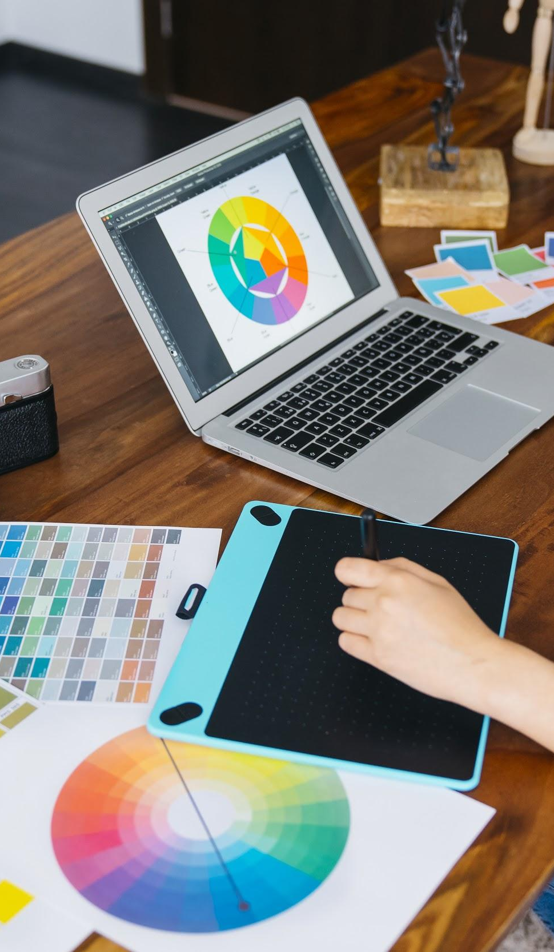
WHAT IS USABILITY TESTING
The practice of testing how easy a design is to use with a group of representative users.
Plan
Set user tasks
Recruit testers
Facilitate/Moderate testing

Slide 13
HOW DO I CREATE PERSONAS ?
Know the users: who are they? Why would they want to use your product? What do they want to achieve by using it? How can they find out about your product?
Identify common factors: look for specific and repeatable metrics to discover common factors and then separate all possible groups.
Narrow your search: Filter the groups. You don’t need too many UX personas. The research process will only distract you from your goal.
Make it specific: Select a suitable person to represent your group and give this person a name. Choose an appropriate image of a person to represent a named group. Describe their character, their likes, dislikes (even the name of their dog). Make this UX Persona seem like a real person.

Slide 14
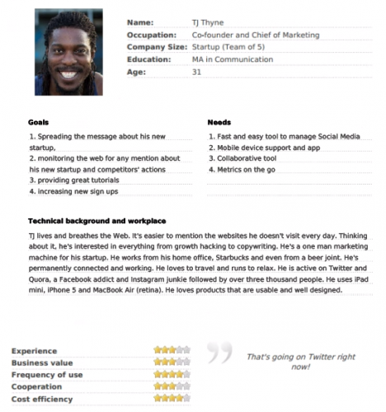
EXAMPLE OF A PERSONA

Slide 15
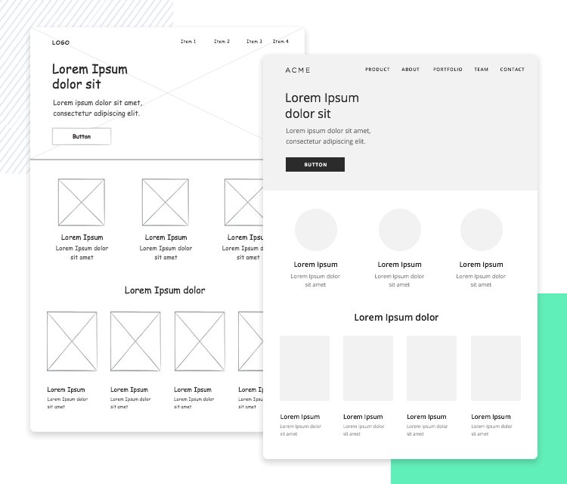
Prototype and test as you learn

Slide 16
WHAT IS PROTOTYPING ?
“A simulation or sample version of a final product, which is used for testing prior to launch.” The goal of a prototype is to test products (and product ideas) before sinking lots of time and money into the final product.
Representation — The actual form of the prototype, i.e., paper and mobile, or HTML and desktop.
Precision — The fidelity of the prototype, meaning its level of detail, polish, and realism.
Interactivity — The functionality open to the user, e.g., fully functional, partially functional, or view-only.
Evolution — The lifecycle of the prototype. Some are built quickly, tested, thrown away, and then replaced with an improved version (this is known as “rapid prototyping”).

Slide 17
PAPER PROTOTYPING
Advantages:
Fast
Inexpensive
Team-building
Documentation
Disadvantages:
Unrealistic
False positives
No gut reactions

Slide 18
DIGITAL PROTOTYPING
Advantages:
Realistic interactions
Flexibility
Speed
Disadvantages:
Learning curve
Transitioning to code

Slide 19
HTML PROTOTYPING
Advantages:
Technical foundation for final product
Platform agnostic
Low cost
Disadvantages:
Dependent on designer skill level
Inhibits creativity

Slide 20
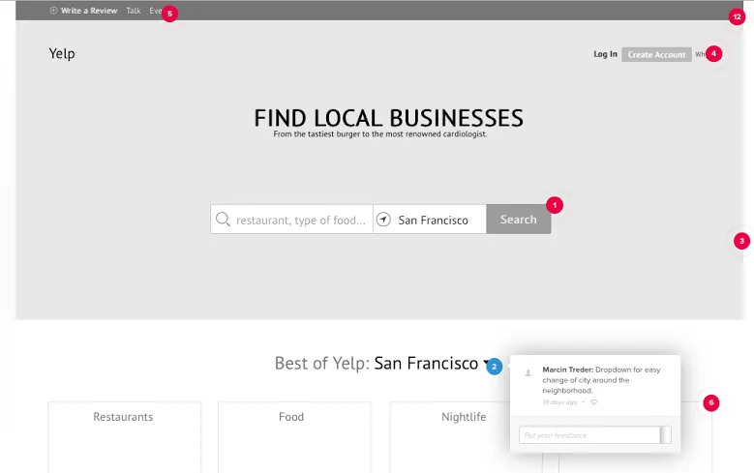
Copyright: Yelp

Slide 21
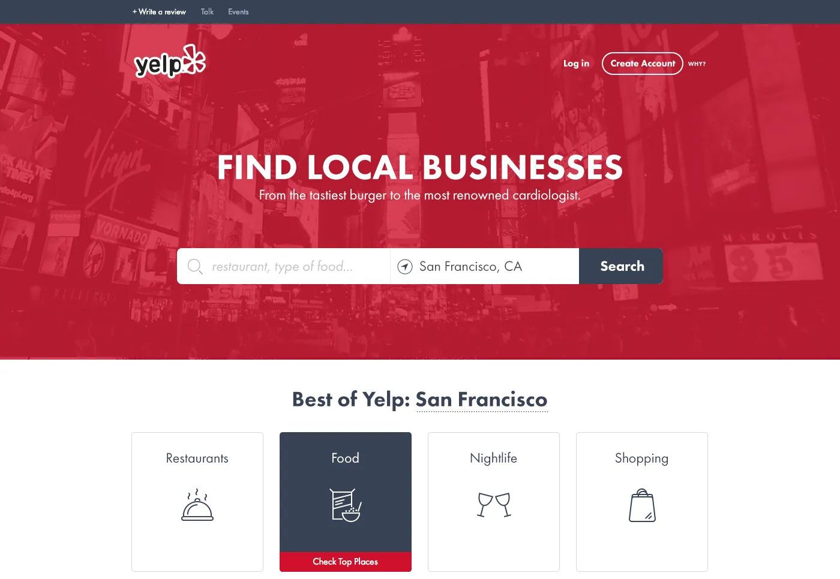
Copyright: Yelp

Slide 22
CONTENTS
Lo-fi Digital | Paper
Hi-fi Digital | Lo-fi Digital | HTML Prototyping
Code | Code | Code

Slide 23
04
VISUAL
DESIGN
Visual design focuses on the aesthetics of a site and its related materials by strategically implementing images, colors, fonts, and other elements.

Slide 24
ELEMENTS OF VISUAL DESIGN
Lines connect two points and can be used to help define shapes, make divisions, and create textures.
Shapes are self-contained areas.
Color palette choices and combinations.
Texture refers to how a surface feels or is perceived to feel.
Typography refers to which fonts are chosen, their size, alignment, color, and spacing.
Form applies to three-dimensional objects and describes their volume and mass.

Slide 25
PRINCIPLES OF CREATING UI
Unity
Gestalt
Space
Hierarchy
Balance
Contrast
Scale
Dominance
Similarity

Slide 26
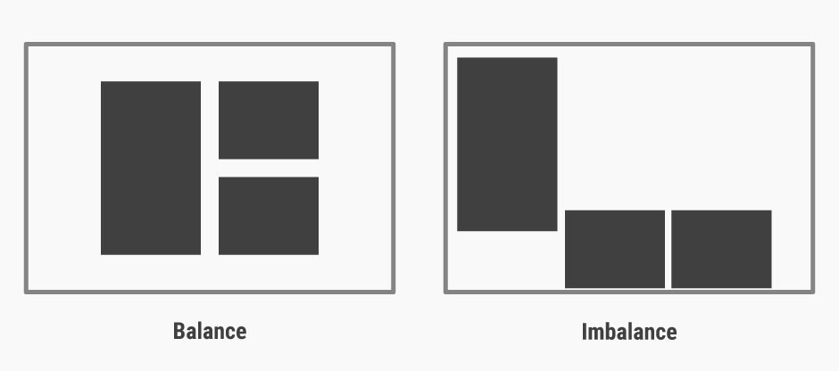
PRINCIPLES OF CREATING UI
Copyright: https://www.interaction-design.org/

Slide 27
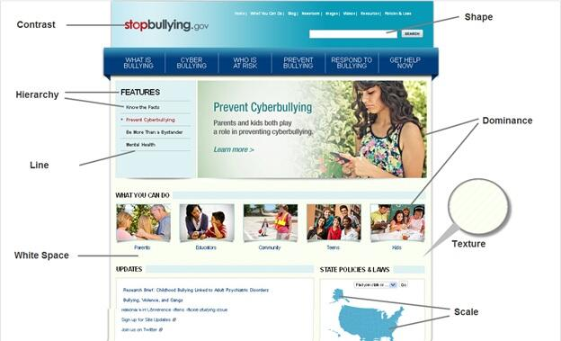
Copyright: https://www.interaction-design.org/

Slide 28
WHAT IS A DESIGN SYSTEM ?
A design system is a collection of reusable components, guided by clear standards, that can be assembled together to build any number of applications. How to build one:
Conduct a visual audit — Taking inventory of the CSS you’re using and the visual qualities of the elements can help you gauge how much of an undertaking this process might be.
Create a visual design language — Your visual design language is made up of four main categories, and you should consider the role each of these design elements plays in every component on the screen. Color, Typography, Sizing and spacing, Imagery.
Create a UI/pattern library — Collect all of the parts and pieces of your UI currently in production.
Document what each component is and when to use it — Use existing pattern libraries to extract standards to use in your documentation.

Slide 29
UI TESTING
User interface testing, a testing technique used to identify the presence of defects is a product/software under test by using Graphical user interface [GUI].
UI Testing covers the range of all visual indicators and graphic-based icons – toolbars, fonts, menus, text boxes, radio buttons, checkboxes, colors, and more.
Some of the features included in UI test suites include:
Functionality
Visual Design
Performance
Usability
Compliance

Slide 30
UI TESTING
Here are a few essential test cases that UI tests tend to verify:
Data type errors: The test checks that only valid data can be entered for certain data fields such as dates, currency, etc.
Field widths: The test checks that certain text fields do not allow the user to place inputs over a specific character limit.
Navigational elements: The test checks that all navigational buttons on a page are working, and that they redirect users to the right page.
Progress bars: The test checks that when displaying pages or screens that take time to load completely, a progress bar appears to let the user know that the page is loading.
Type-ahead: If the UI uses drop-down lists, type-ahead is required. In a drop-down menu with multiple options, the user should be able to find the right one by typing the first letter. Making the user go through a long list constitutes unfavorable user experience.
Table scrolling: If the website has data tables, and if the table extends into a second page, then the user should be able to scroll through all the data while keeping the headers visible and in place.
Error Logging: This test checks that in case of a system error, the software records error details to a log file so that it can be reviewed later.
Menu Items: The test checks that the software displays only the menu available in its particular geographical location (if that is applicable).

Slide 31
05
SHORTCUTS
So can do you do now ?

Slide 32
01
02
LOGOS
RESEARCH YOUR
BRAND
CHOOSE A LOGO STYLE
03
04
GET COLOR AND SYMBOL IDEAS
MAKE YOUR
LOGO
Identify who your customers are and who your competitors are.
Learn about logos
1. Wordmark
2. Monogram
3. Combination
Match your logo to your competitors
Use your gathered
Research

Slide 33
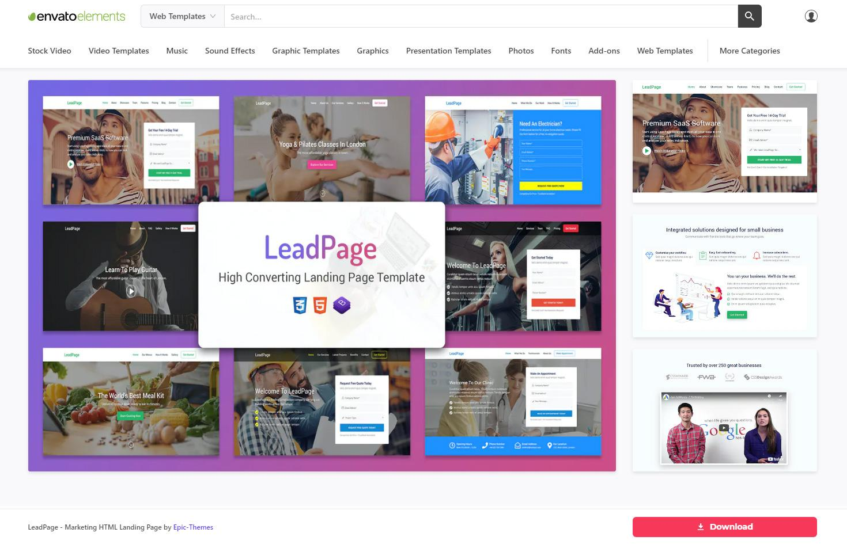
CHOOSING A UI TEMPLATE

Slide 34
WHAT TO LOOK FOR IN A DESIGNER
Find and evaluate portfolios on:
Behance
Carbonmade
Dribbble
ArtStation
Be on the look of:
Always consider the user
Gracefully handle criticism
Help team members improve
Always willing to grow

Slide 35
06
TOOLS
What tools can you use ?

Slide 36
PRACTICAL EXERCISE
Figma (figma.com)
Looka (looka.com)
Renderforest (renderforest.com)
Justinmind (justinmind.com)
Envato.com
UXPIN
Google Forms
Crazy Egg
Optimizely
Fivesecondtest.com

Slide 37

QUESTIONS:

Slide 38
THANKS!
All the best.

